Slide 1

^{7th} Semester
Major Project Phase – I (CSEP23706)
Review 1
Group No. | G14 | Project ID | P43
Project Title | Implementation of a Secure CI/CD Pipeline Using DevOps Tools
Student Name | Revanth Kumar T S | USN | 1GA23CS137
 | Sanket |  | 1GA23CS148
 | Shakthi Vel K |  | 1GA23CS151
 | Vignesh P |  | 1GA23CS193
Guide Name | Prof. Sameena H S , Assistant Professor

Slide 2
Agenda
Problem Statement
System Architecture
Design Diagrams
Requirements Specification
Implementation
Results

Slide 3
Problem Statement
Security vulnerabilities are often detected after deployment
This leads to:
    Increased risk of cyberattacks
    High remediation and maintenance costs
    Delays in software releases
    Lack of automated security integration in traditional DevOps pipelines
Need for early vulnerability detection in development lifecycle

Slide 4
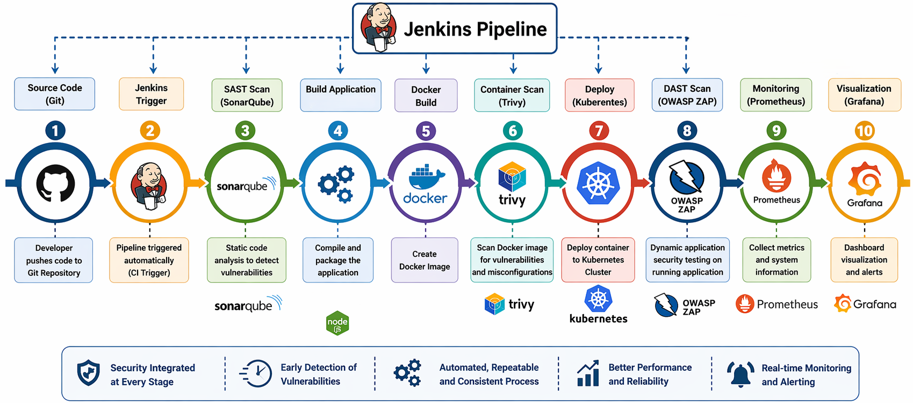
System Architecture
The DevSecOps CI/CD architecture automates the software lifecycle where code pushed to GitHub triggers Jenkins for build, testing, and security scanning using SonarQube and OWASP ZAP/Trivy.
The application is then containerized with Docker, deployed using Kubernetes on cloud platforms (AWS/Azure), and continuously monitored using Prometheus and Grafana.
Fig.1 : DevSecOps CI/CD architecture

Slide 5
Data Flow Diagram
Definition:
A Data Flow Diagram is a graphical representation that shows how data moves through a system. It illustrates the inputs, outputs, processes, and data stores within a system without showing control flow or timing.

Slide 6
Data Flow Diagram
DFD Level 0 — Context Diagram
The topmost level of DFD that represents the entire system as a single process. It shows how the system interacts with the outside world.
DFD Level 1
Level 1 breaks the single process of Level 0 into major sub-processes (main functions of the system). Data stores are introduced at this level.
DFD Level 2
Level 2 further decomposes each Level 1 process into detailed sub-processes. Each major process from Level 1 gets its own Level 2 DFD.

Slide 7
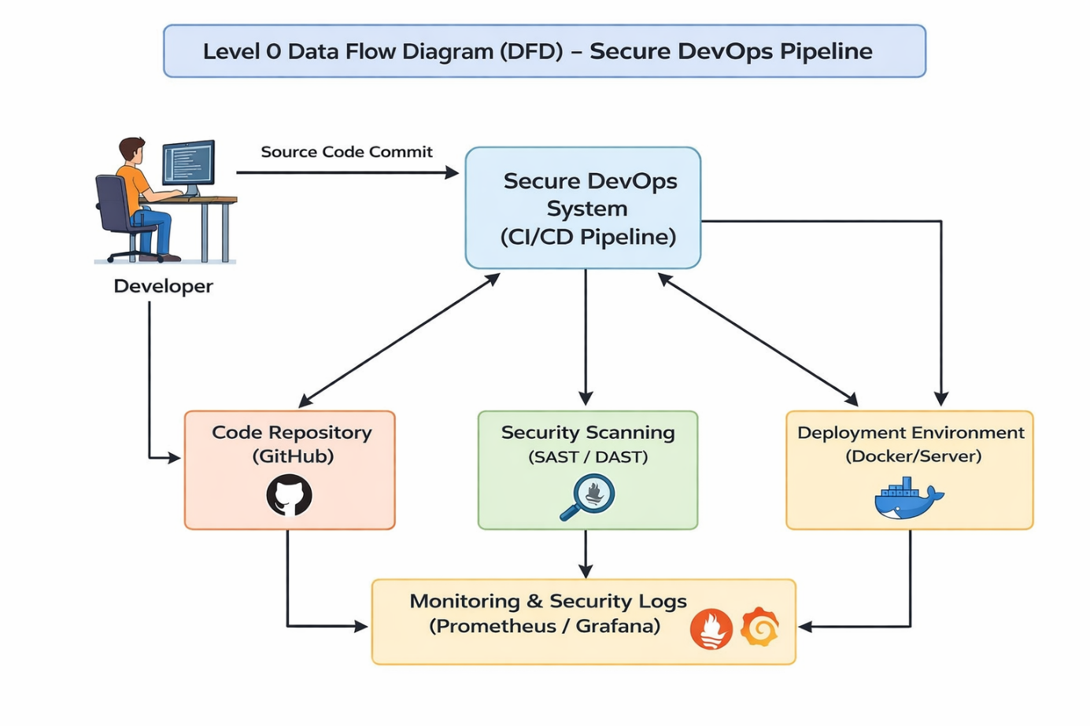
Data Flow Diagram
Level 0 DFD
The Level 0 DFD shows how the developer commits source code to the Secure DevOps CI/CD system, which processes it through code repository, security scanning, and deployment environment.
The system then performs security analysis and deployment while continuously monitoring logs and performance using Prometheus and Grafana.
Fig. 2.1 : DFD Level 0 DevSecOps CI/CD

Slide 8
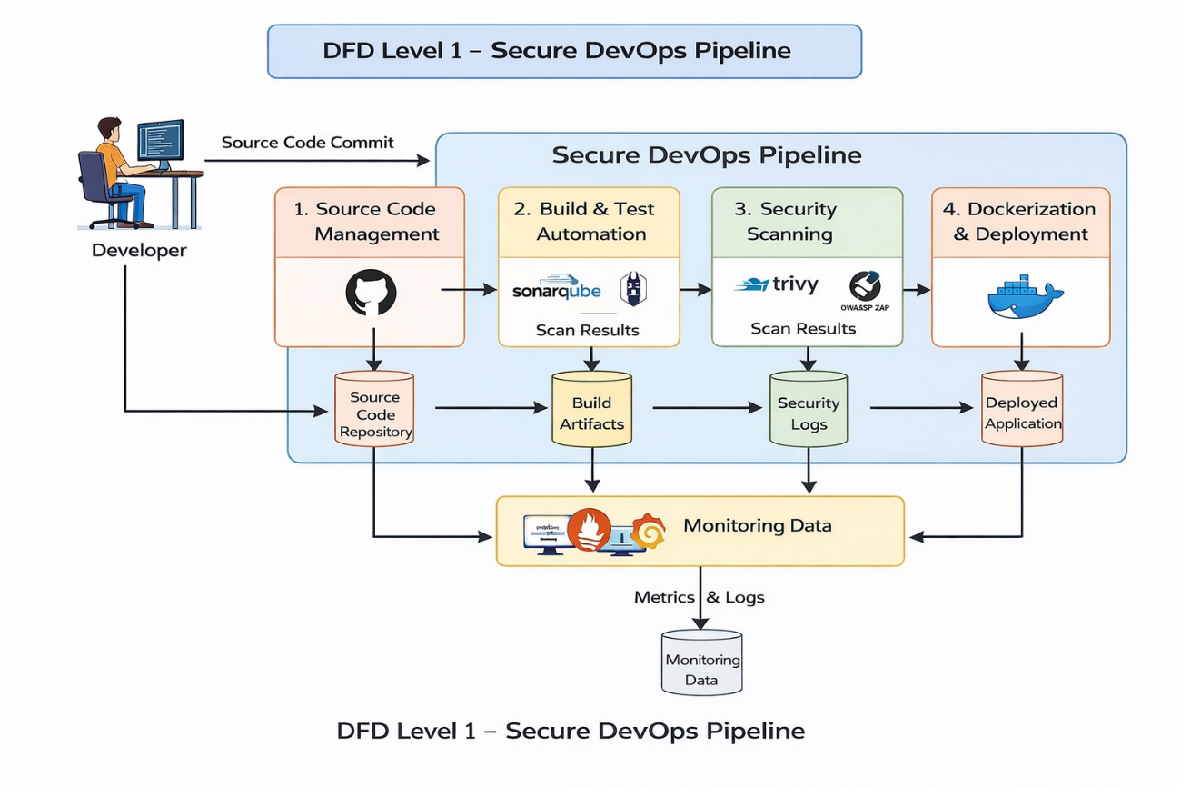
Data Flow Diagram
Level 1 DFD
The Level 1 DFD breaks the Secure DevOps pipeline into four processes: Source Code Management, Build & Test Automation, Security Scanning, and Dockerization & Deployment.
Code from the developer is stored in the repository, tested and scanned for vulnerabilities, deployed as containers, and monitored using Prometheus and Grafana for logs and metrics.
Fig. 2.2 : DFD Level 0 DevSecOps CI/CD

Slide 9
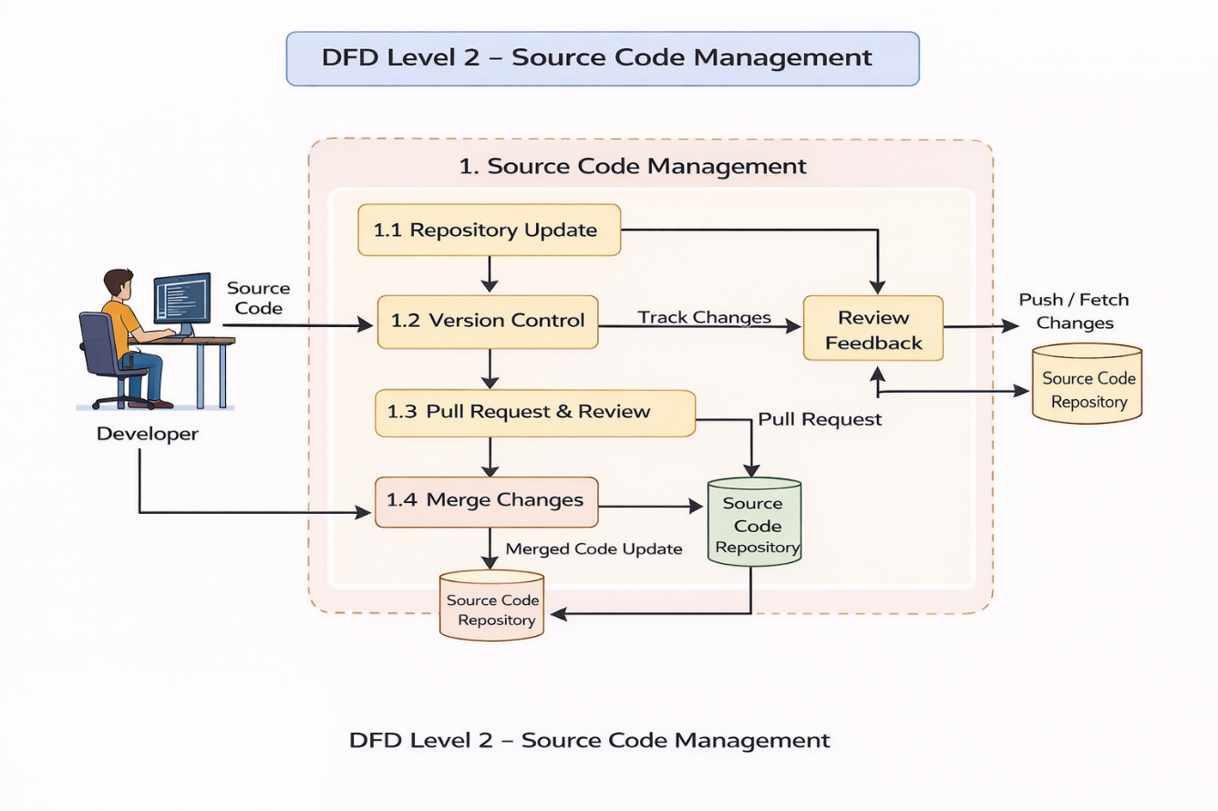
Data Flow Diagram
Level 2 DFD
The Level 2 DFD details the Source Code Management process, where developers update the repository, manage versions, create pull requests, and review code changes.
After review and approval, the code is merged and stored in the source code repository, making it ready for the CI/CD pipeline.
Fig. 2.3 : DFD Level 0 DevSecOps CI/CD

Slide 10
Requirements Specification
Hardware Requirements
Minimum Hardware
Processor: Intel i5 / AMD Ryzen 5
RAM: 8 GB
Storage: 256 GB SSD
Internet connection (for GitHub, updates, plugins)
Recommended Hardware
Processor: Intel i7 / AMD Ryzen 7
RAM: 16 GB
Storage: 512 GB SSD
Virtualization support enabled (for Docker & Jenkins)

Slide 11
Requirements Specification
Software Requirements
Operating System : Windows 11 (64-bit)
Git / GitHub – Version control and source code repository
Jenkins – CI/CD automation tool for build and testing
SonarQube – Static code analysis for vulnerability detection
OWASP ZAP / Trivy – Security scanning tools
Docker – Containerization platform for application
Kubernetes – Container orchestration for deployment
Prometheus & Grafana – Monitoring and logging tools
AWS / Azure Cloud – Cloud platform for hosting and deployment

Slide 12
Implementation
Configure GitHub repository.
Integrate GitHub with Jenkins.
Create Jenkins pipeline.
Run SonarQube analysis.
Perform OWASP ZAP and Trivy scans.
Build Docker image and deploy on Kubernetes.
Monitor using Prometheus and Grafana.

Slide 13
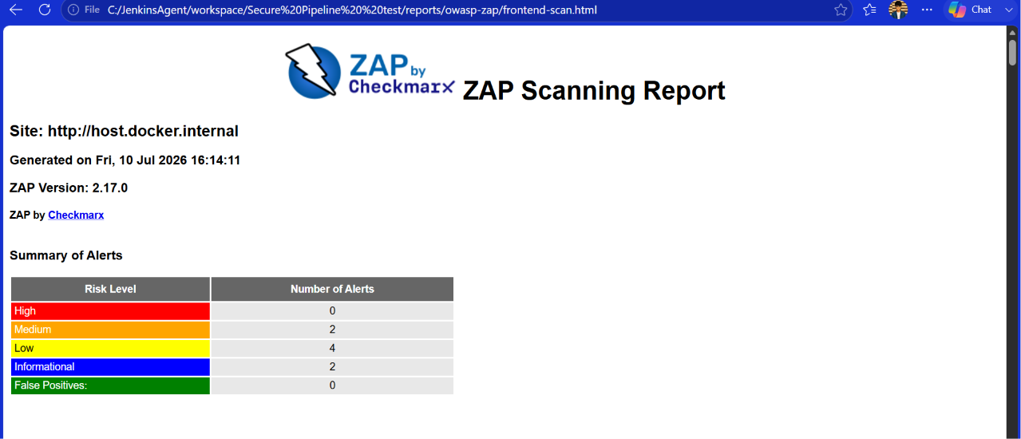
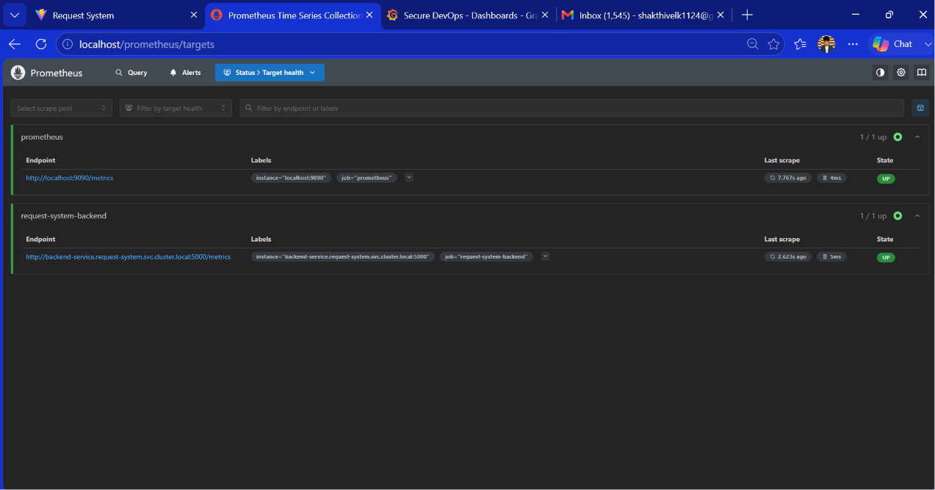
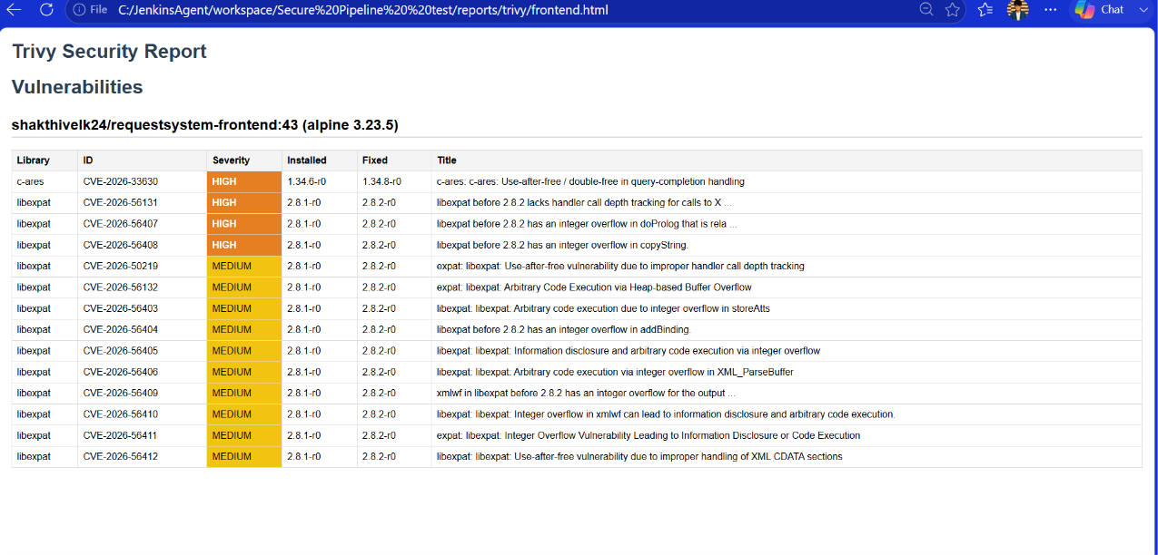
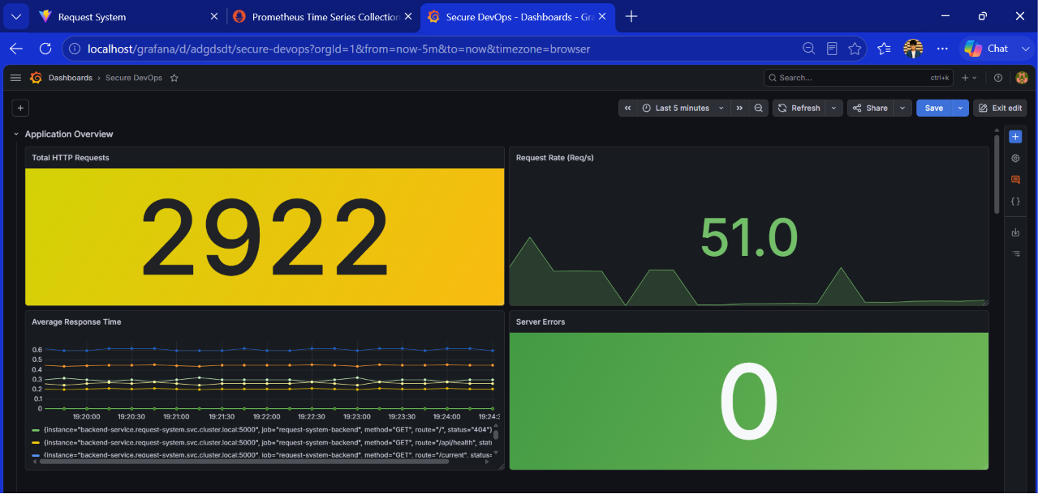
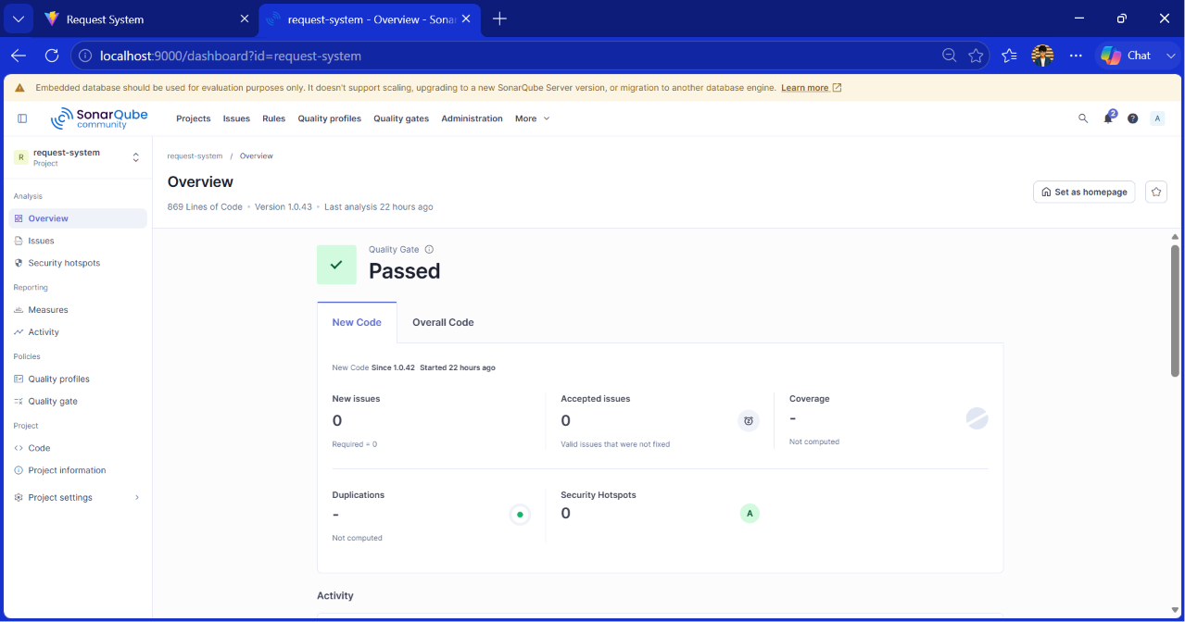
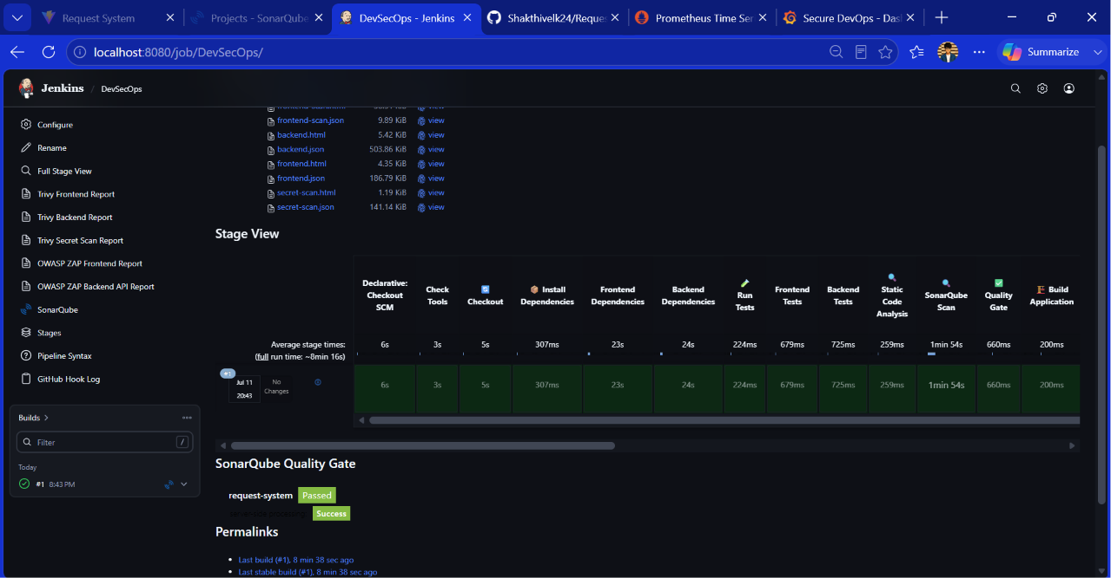
Results

Slide 14
Q & A

Slide 15
Thank You

